Slide 1


Fall 2020
Advanced Affective Neuroscience
CHOONG-WAN WOO | COCOAN lab | http://cocoanlab.github.io

Slide 2
Affective Neuroscience | Fall 2020
Lecture 01
Lecture 01-2
Class overview and paper assignment
CHOONG-WAN WOO | COCOAN lab | http://cocoanlab.github.io

Slide 3
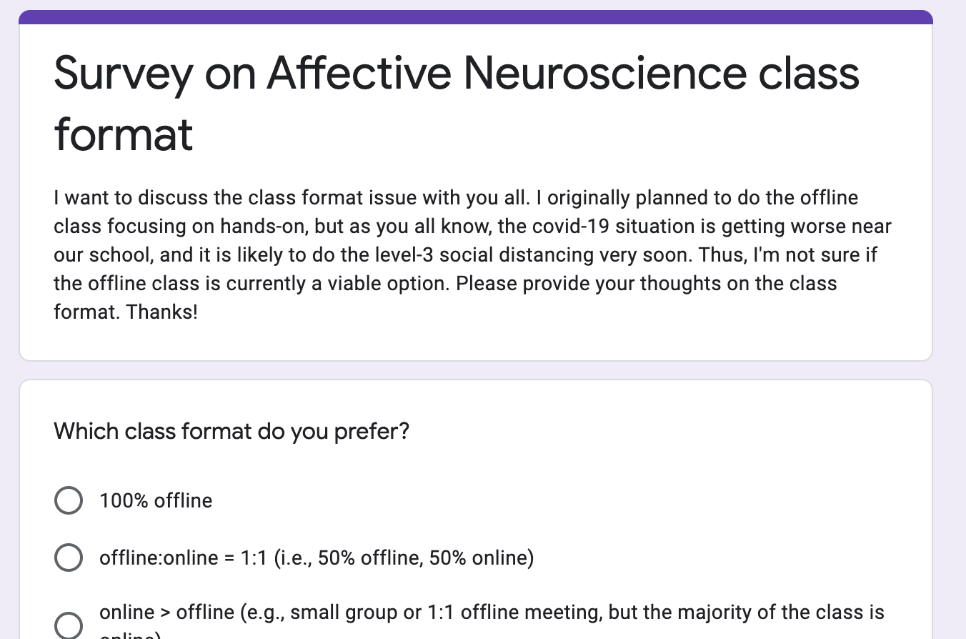
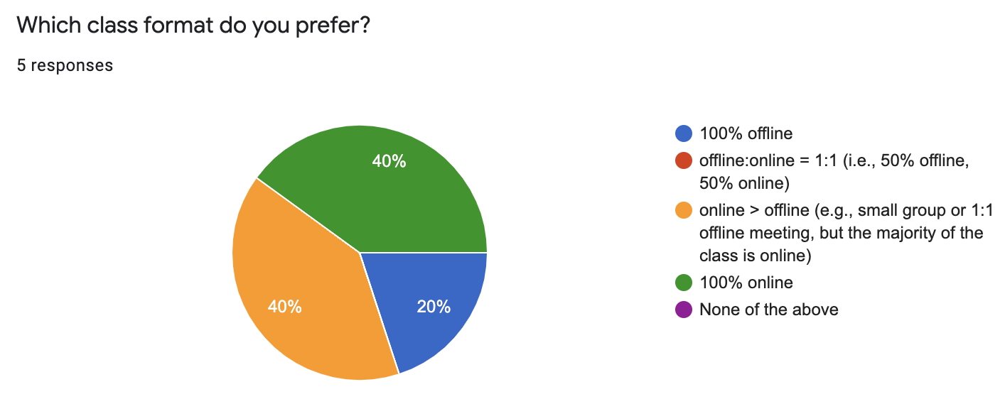
Changes since the first video was recorded
2nd wave of covid-19
Social distancing level 2.5
Did a survey on the class format
5 students answered ㅠㅠ
40% (2 students) selected ”100% online”
40% (2 students) selected ”online>offline”
We can start with 100% online, but as time goes on, we can try to add some offline component
CHOONG-WAN WOO | COCOAN lab | http://cocoanlab.github.io

Slide 4
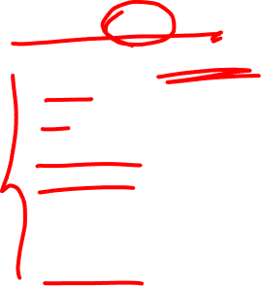
Slide credit: Tor Wager
What is affective neuroscience?
Affective neuroscience?
Study of human brain systems related to:
Emotion
Value and decision-making
Visceral sensations
Social cognition
Brain-body communication
Brain health disorders (Parkinson’s, pain, PTSD)
Physical health and well-being
Human
Neuroscience
Affective neuroscience
Systems
Neuroscience
Computation and
statistics
Cognitive and Social Psychology
CHOONG-WAN WOO | COCOAN lab | http://cocoanlab.github.io

Slide 5
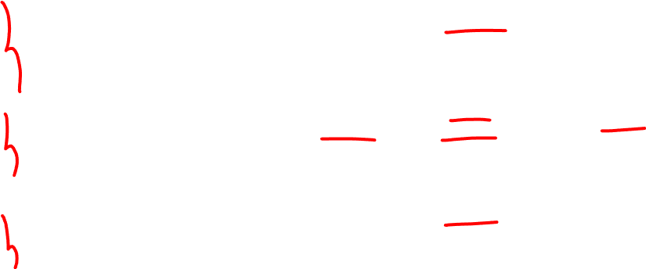
Slide credit: Tor Wager
Related emerging fields
Behavioral
Motivation sciences
Social neuroscience
Decision science
Neuroeconomics
Medical
Psychosomatic medicine
Psychoneuroimmunology/-endocrinology
Integrative medicine (mind-body medicine)
Technical
Informatics
Machine learning
Medicine
Affective neuroscience
Psychiatry
Clinical psychology
Social work
Law and policy
Psychology
CHOONG-WAN WOO | COCOAN lab | http://cocoanlab.github.io

Slide 6
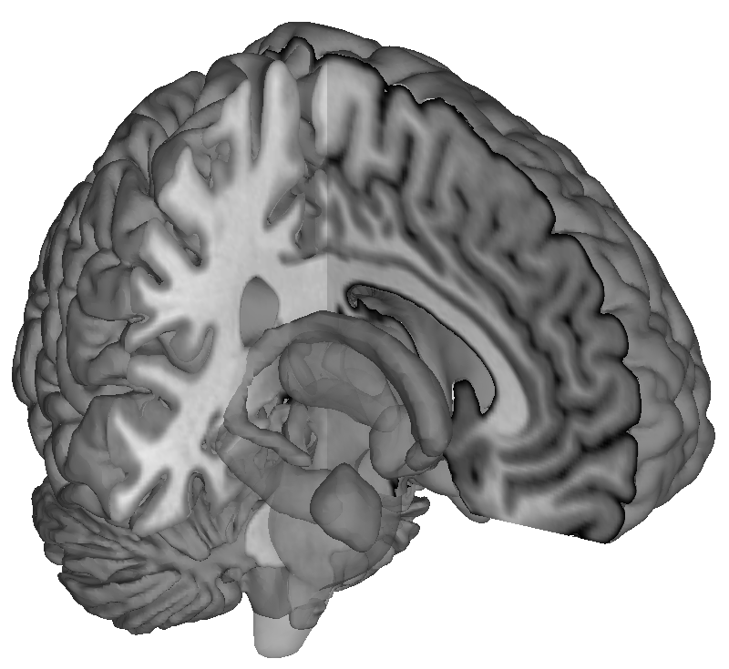
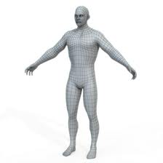

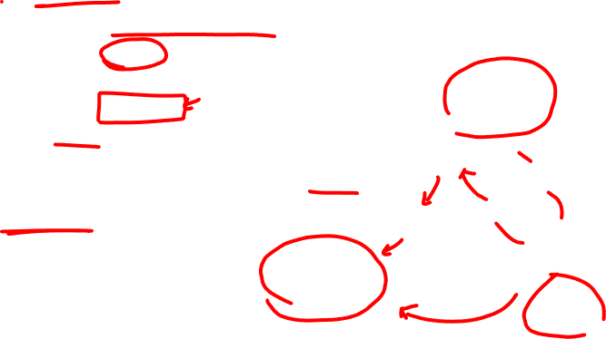
Slide credit: Tor Wager
Example research questions of affective neuroscience
What is the role of the brain in health?
Can we establish a physical basis for mental health disorders?
Can we develop better measures of emotion and emotional health?
Can we discover physical mechanisms underlying feelings?
Can we understand willpower and self-control from a neurophysiological perspective?
Can this help us develop better interventions?
Can we measure feelings from patterns of brain activity?
Could this change legal practice and argumentation?
Brain
Interoception
Behavior
Sensation
Visceral
regulation
Body
Environmental
exposure
Social environment
Physical environment
CHOONG-WAN WOO | COCOAN lab | http://cocoanlab.github.io

Slide 7
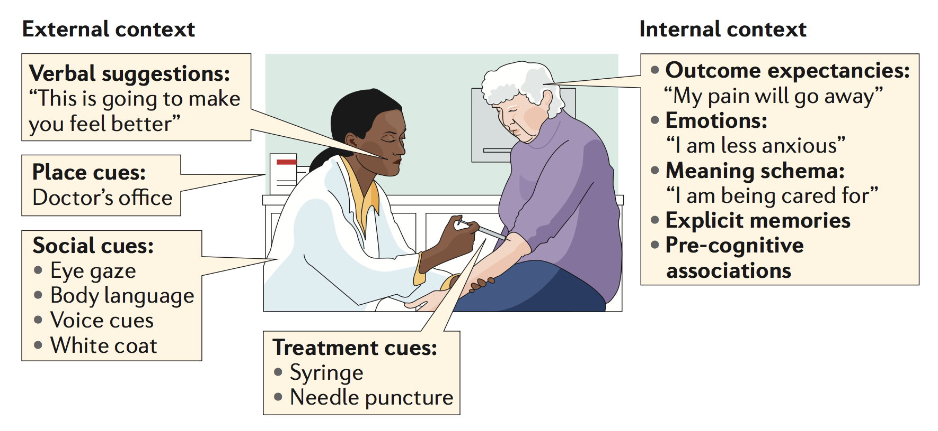
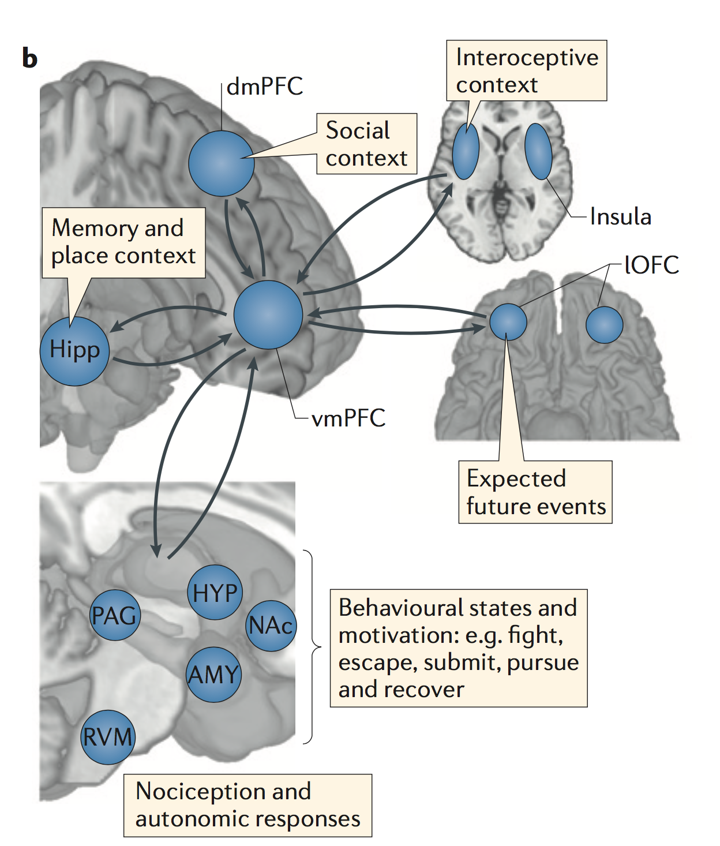
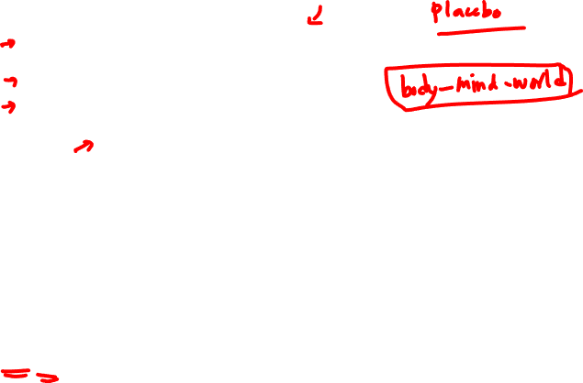
Slide credit: Tor Wager
Example research questions of affective neuroscience
Treatment effects and contexts
Wager & Atlas, 2015, Nat Rev Neurosci
CHOONG-WAN WOO | COCOAN lab | http://cocoanlab.github.io

Slide 8
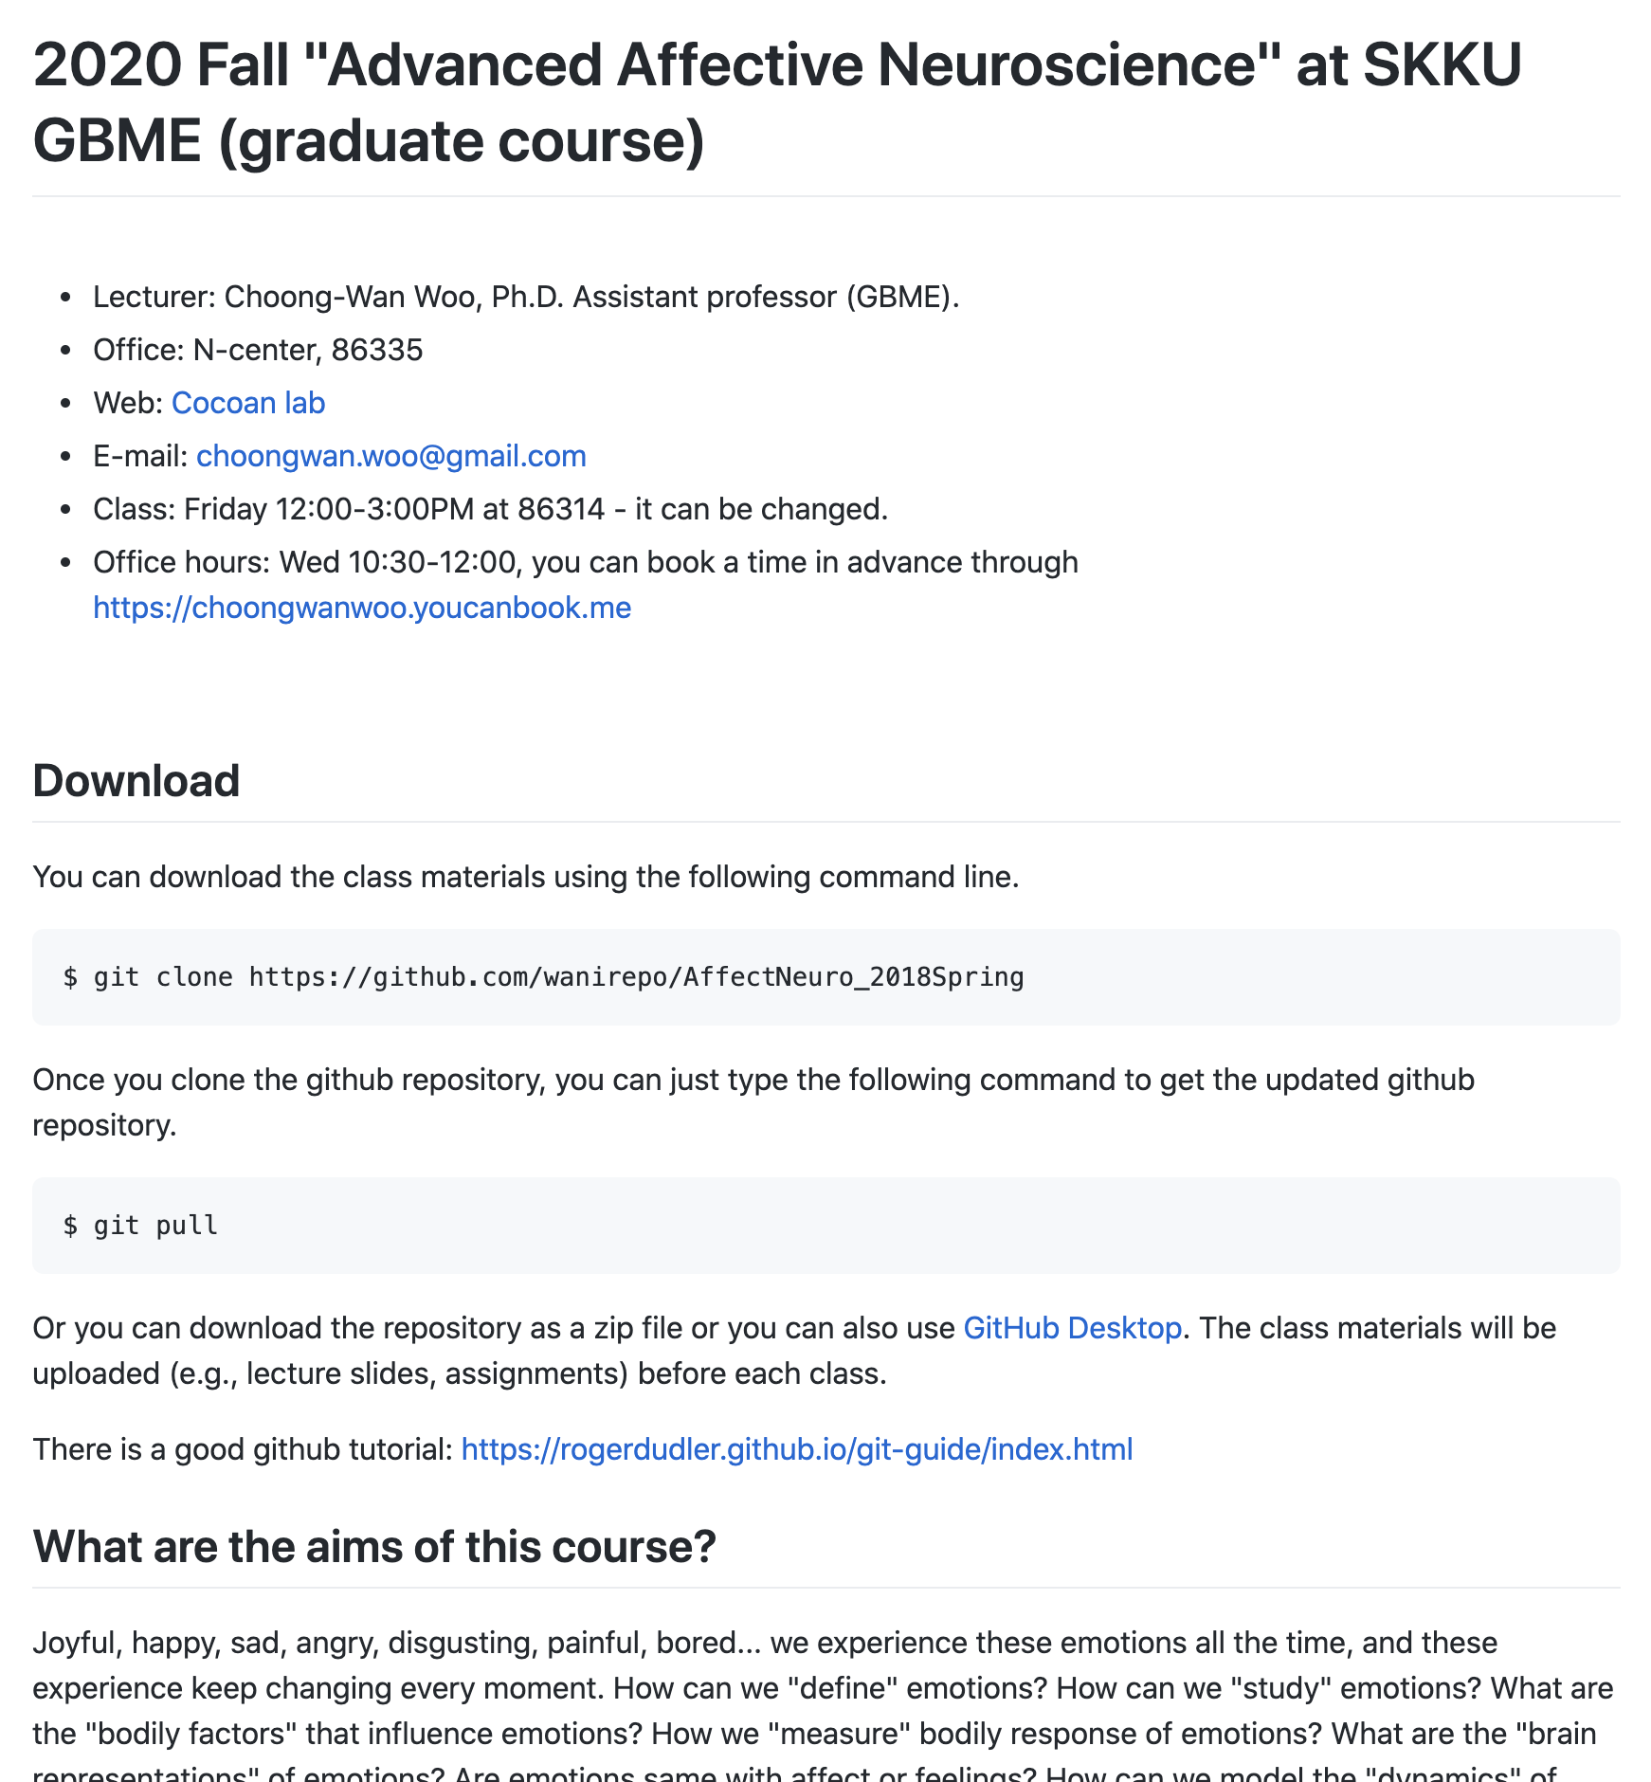
https://github.com/wanirepo/AffectNeuro_2020Fall
CHOONG-WAN WOO | COCOAN lab | http://cocoanlab.github.io

